Slide 1

LastChance Air
Smart Last-Minute Flight Deals Platform
Discover the LastChance Air platform, a full-stack web application designed to revolutionise last-minute flight bookings. Inspired by industry leaders like Expedia and Skyscanner, this platform focuses on securing discounted seats for domestic U.S. flights when airlines need to fill them quickly.
Team Members:
Vijay Krishna Ramraj
Lokesh Dhamodharan
Kalyan Uppalapattti
Team: Team 8
December 16
Website: lastchanceair.netlify.app
Notes:
Hello everyone, we are Team 8, and this is our project LastChance Air.
It’s a smart last-minute flight deals platform designed to help travelers find affordable flights quickly.
Our project is inspired by systems like Expedia and Skyscanner, but focused specifically on urgent, last-minute travel.
Today we’ll walk through the problem, our solution, system design, implementation, and finally a live demo.

Slide 2

Problem Statement
Problem Statement
Airlines lose revenue due to unsold seats close to departure.
Key Statistic: 15–20% of domestic flights depart with empty seats.
Travelers struggle to find affordable last-minute flights.
Existing platforms (Expedia, Skyscanner) are optimized for all travel types, not urgent trips.
Need for a simple, fast, deal-focused platform.
Goal: Bridge the gap between airline seat loss and traveler needs.
Notes:
Airlines lose significant revenue because flights still depart with empty seats — about 15–20%.
At the same time, customers struggle to find affordable last-minute flights.
Existing travel sites are designed for all types of travel, not specifically for urgent bookings.
So our goal is to bridge this gap by providing a simple, fast, and deal-focused platform.

Slide 3






Project Overview
LastChance Air is a flight-booking simulation that identifies near-term flight availabilities (3–7 days) and applies dynamic discounting logic to offer last-minute deals.
Here's a simple flow of how LastChance Air processes a user request:
User
Search
Backend
Initiates a flight search
Submits search criteria
Processes the request
Pricing Engine
Results
Applies dynamic discounts
Displays last-minute deals
Notes:
LastChance Air simulates a real flight booking workflow.
We focus on flights departing within 3–7 days, where discounts matter most.
The flow is simple: the user searches → backend processes → pricing engine applies discounts → results are displayed.
Our main focus is to make this process quick, lightweight, and easy for users in a hurry.

Slide 4







Key Features
Flight Search
Dynamic Discounts
By city, date, airline, and departure window
Based on time-to-departure + seat availability
Deal Highlighting
Responsive UI
Shows lowest last-minute prices
Mobile-friendly interface
Booking Simulation
Fast, Lightweight UX
Select flight, seat availability, confirmation
Optimized for speed and efficiency
Notes:
We implemented a complete flight-search system with dynamic discounts.
Deals are highlighted automatically based on availability and time-to-departure.
The interface is fully responsive and mobile-friendly.
Users can also simulate bookings to see seat availability and confirmation.
Overall, the platform is optimized for speed and fast decision-making.

Slide 5
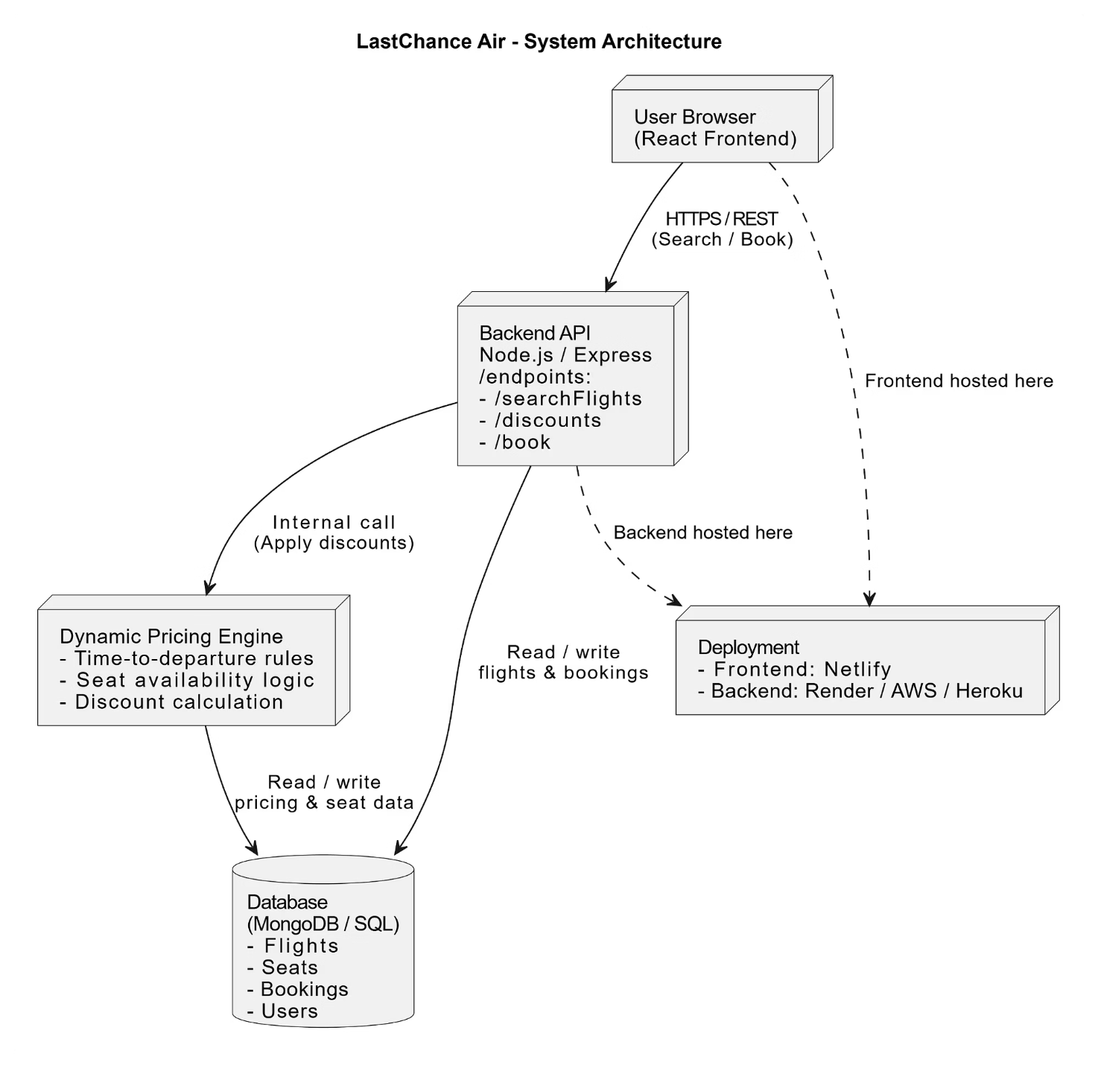
Slide 5
System Architecture
Key Architecture Notes:
Frontend: React-based user interface for seamless interaction
Backend: Node.js/Express API endpoints for robust server logic
Database: SQLite for efficient data storage and retrieval
Dynamic Pricing: Real-time discount calculation engine
Deployment: Netlify & Cloud hosting for scalable and reliable service
Notes:
Our system uses a clean full-stack architecture. On the frontend, we use React with TailwindCSS to give users a fast, responsive, interface.
The backend is built with Node.js and Express, which handles all the main logics like search, booking, authentication, and discount calculations. All our data, including users, flights, seats, and bookings, is stored in a lightweight SQLite database that keeps everything simple and efficient.
We also have a dynamic pricing engine that adjusts discounts in real time based on seat availability and how close the flight is to departure.
Finally, the frontend is deployed on Netlify and the backend runs on a cloud service (render), which makes the system easy to access and test from anywhere.

Slide 6
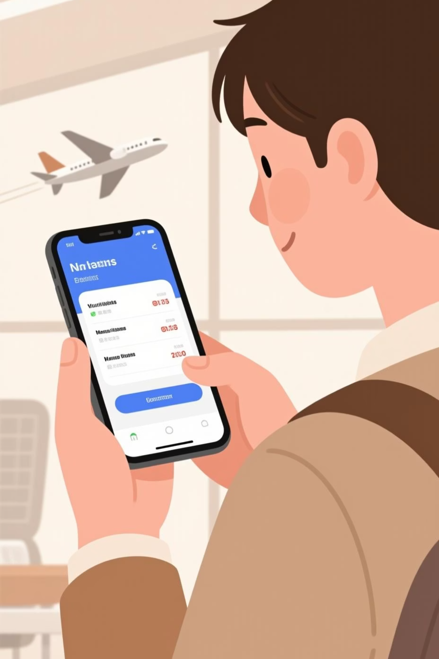
Slide 6
Frontend Implementation
Built using modular reusable components.
API calls for flight search and pricing.
Sort & filter logic for deals.
Clean card-based UI for readability.
Responsive design ensures smooth mobile + desktop experience.
UI Library: Tailwind CSS for styling and responsive design
Key Screens:
Search Page
Deal Results Page
Booking Confirmation Page
Notes:
We kept the frontend modular so it’s easy to update and maintain.”
“The UI connects to the backend through API requests for flights and pricing.”
“We added quick sorting and filtering to help users identify the best deals.”
“The design works smoothly on both mobile and desktop screens.”

Slide 7

Slide 7
Backend Implementation
Search API
Pricing Engine
Response
API Endpoints:
/searchFlights – Fetch flights by date, location
/discounts – Apply discount logic
/book – Simulate booking process
Notes:
This is the backend flow. A search request first hits the Search API, which finds matching flights. Then it goes into the Pricing Engine, where we apply discount logic. Finally, the backend sends the processed results back to the frontend as a JSON response. So the sequence is: Search → Pricing → Response.”

Slide 8
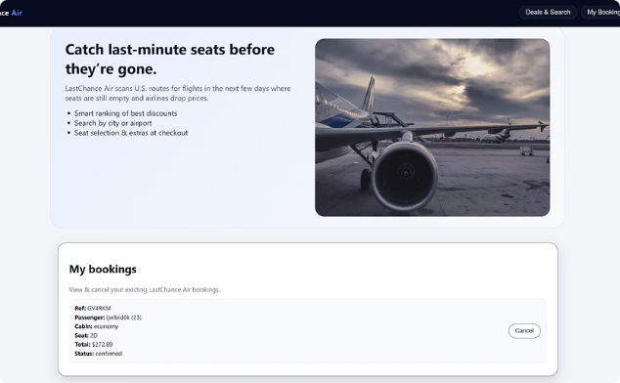
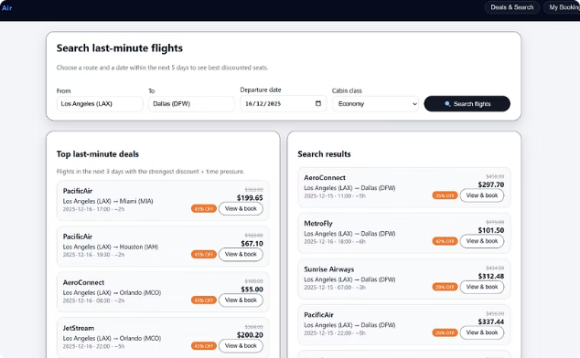
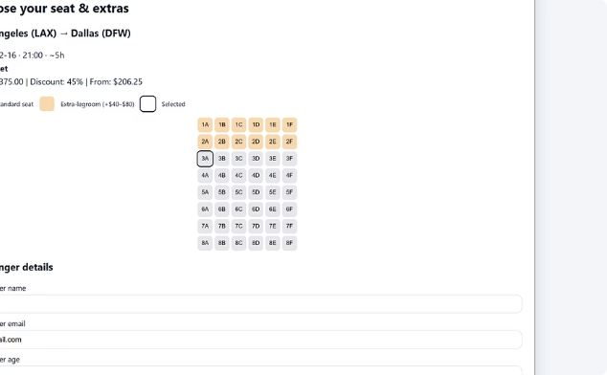
User Interface Screens
Key user interface screens demonstrating the complete booking flow from search to seat selection.
Homepage & My Bookings
Flight Search & Results
Seat Selection & Passenger Details
Notes:
Here are the main UI screens that users interact with.
The homepage leads to search → results → booking.
We designed each page to be simple and intuitive.
The layout works smoothly on both mobile and desktop devices.
These screens help users complete their journey quickly.

Slide 9
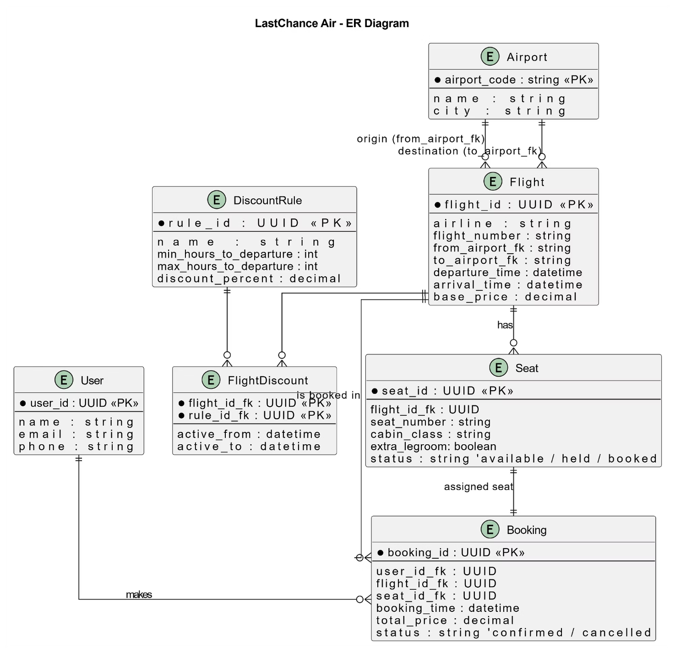
Slide 8
Database Design
Key Database Design Notes:
User: Stores user account information and authentication
Flight: Contains flight details, pricing, and availability
Seat: Manages seat inventory and booking status
Booking: Records user bookings with timestamps
DiscountRule: Defines discount conditions and values
Relationships: Shows how entities connect, ensuring data integrity across the system.
Notes:
Our database is built around five main entities: Users, Flights, Seats, Bookings, and Discount Rules. Users link to bookings, flights link to seats, and discount rules help apply dynamic pricing. These relationships keep data consistent and allow the system to track availability, pricing, and user activity smoothly

Slide 10
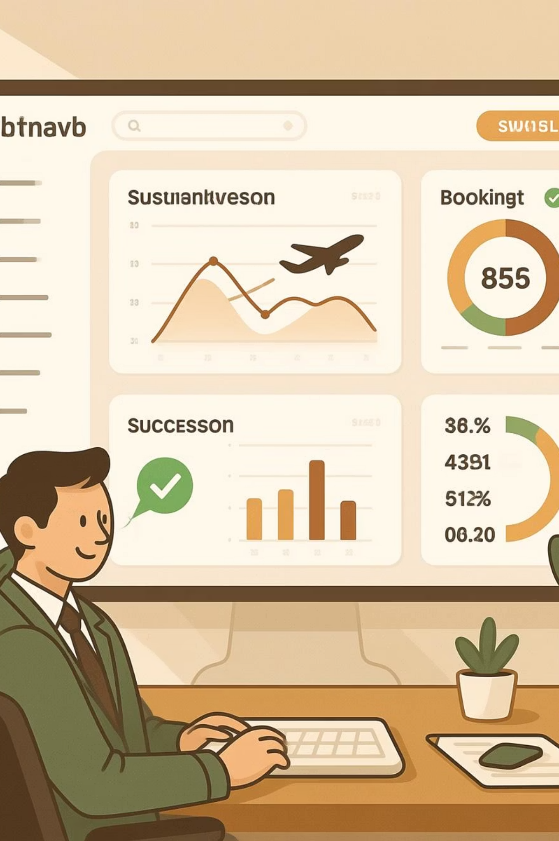
Demo & Results
Live Demo:
Search for a flight → View discounted deals
Select one → Booking confirmation UI
Smooth load times and clean visual layout
Results:
Fully functional search & deal engine
Realistic pricing simulation
Demonstrates complete full-stack workflow
Users can explore urgent travel options within seconds
Performance Metrics:
Average Search Response Time: < 500ms
Page Load Time: < 2 seconds
Sample Pricing: Base $250 → Discounted $175 (30% off)
Notes:
In the live demo, we’ll walk through a real use-case: search → deals → select → confirm booking.
Our system responds quickly, with search times under 500ms.
The UI loads in under 2 seconds, even with dynamic pricing applied.
We simulate realistic pricing—like a $250 ticket discounted to $175.
Overall, the system demonstrates a complete end-to-end workflow.

Slide 11
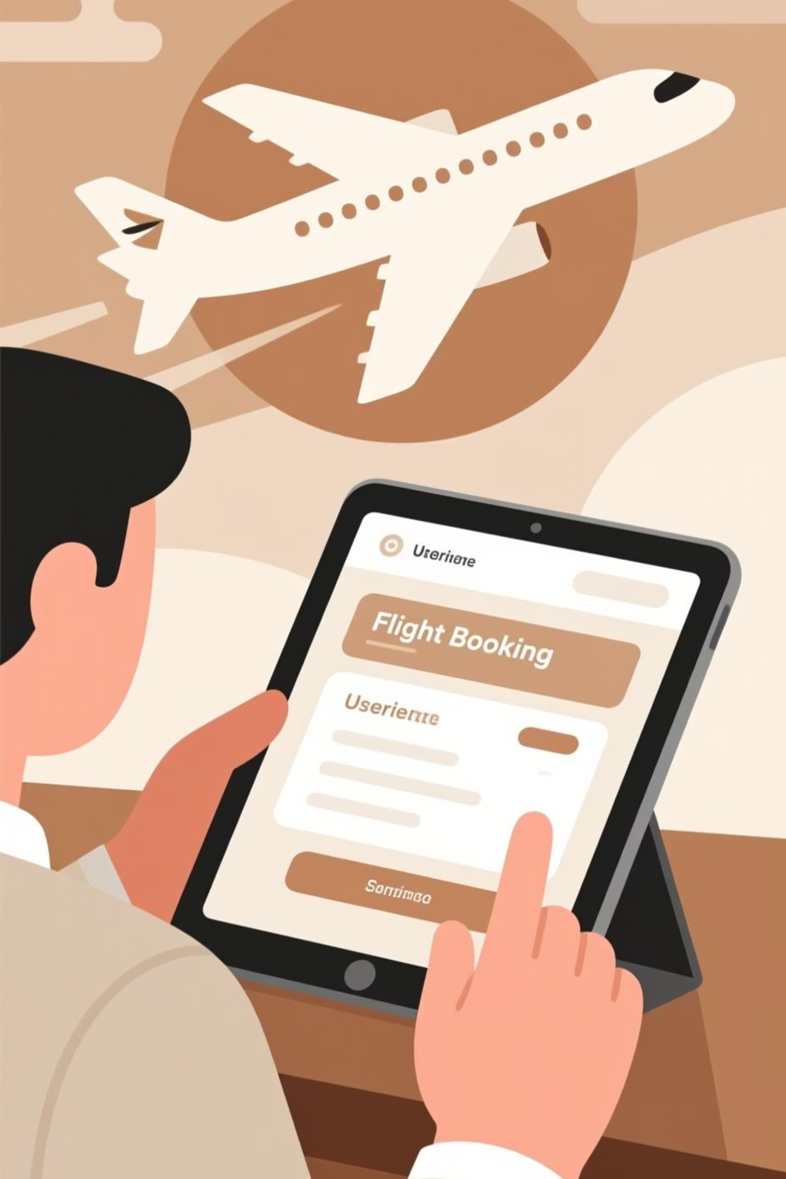
Conclusion & Future Enhancements
Project Achievements:
Built a complete last-minute flight finder
Implemented dynamic pricing logic
Clean UI + reliable backend
Deployed full web system
Future Enhancements (Top Priorities):
Real airline API integration
User accounts & saved searches
Payment gateway & e-tickets
AI-based price prediction
Push notifications for deals
Notes:
“To wrap up, we were able to build a fully working last-minute flight booking system with dynamic pricing, a clean UI, and a stable backend. We also deployed the entire application so it can be tested live.
Looking ahead, there are many opportunities to expand the system. The biggest improvement would be integrating real airline APIs to bring live data instead of simulated flights. We also plan to add user accounts with saved searches, a payment gateway, and automatic e-tickets. In the future, AI could be used to predict pricing trends, and push notifications could alert users when new deals appear. Overall, the project gave us a strong foundation and plenty of ideas for future enhancements.

Slide 12
Thank You

